Slide 1



Classes and Shapes of Roses

Slide 2
Today We are Going to Learn a Few Things About Roses
We are going to learn about the age and origin of roses.
We are going to learn about the importance of the rose to society.
We are going to learn about “classifications”
We are going to learn about bloom shape and size.

Slide 3

Did You Know?
That roses have been around since before the dinosaurs!
Fossils have been found with imprints of roses in Colorado.

Slide 4



Did You Know?
That Scientists think that the rose originated in China.

Slide 5

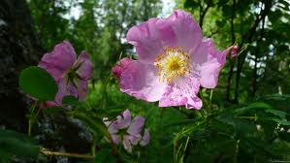
Did You Know?
That no wild roses occurred in nature below the equator? Now they grow just about everywhere….even in Alaska!

Slide 6

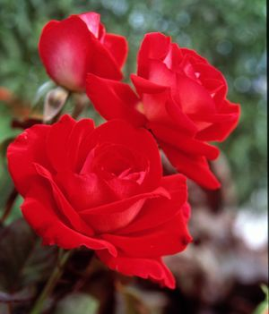
Did You Know?
That President Ronald Reagan signed a proclamation stating that the ROSE should be our National Floral Symbol because so many Americans love roses.
The “Ronald Reagan” Rose-named in honor of our President.

Slide 7
Today’s Lesson about Roses is in
2 Parts
Part 1
This section is about the different classes of roses
Part 2
This section is about the different shapes of the blooms of roses

Slide 8
How Are Roses Classified?
There are many different ways of classifying roses: they may be grouped by :
Variety
Growth habit
Color
Size
Shape of their flowers
The number of petals

Slide 9

There are 35 Classes of Roses

Slide 10
Let’s Learn About Some of Them
To keep this simple, we will start with nine classes (groups) of roses.
You will find each one is different and unique to its class-
just like you!
Here are the classes we will look at today:
Micro-Miniatures
Miniatures
Mini-Floras
Floribundas
Grandifloras
Hybrid Teas
Climbers/Ramblers
Shrubs
Old Garden Roses

Slide 11
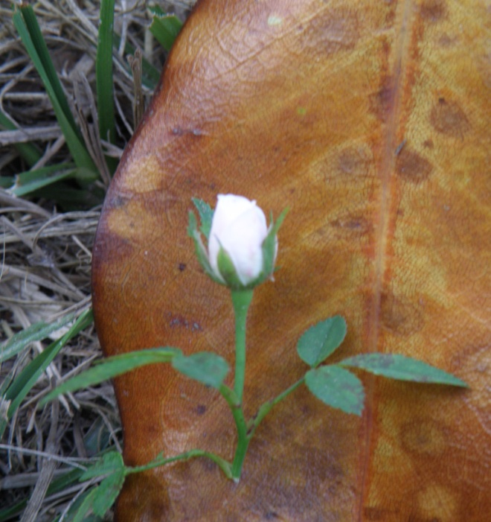
Micro –Miniature Roses
This class of rose is the smallest class you can find. They only reach 12 –14 inches in height and the bloom is the size of a dime when fully opened but looks just like their bigger cousins the hybrid tea.
They can be grown in a flowerpot on your porch or patio!
Micro-Miniature Rose Cinderella

Slide 12
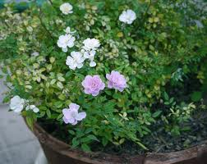
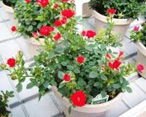
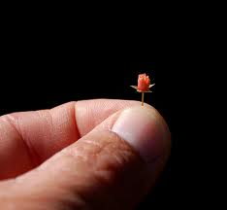
These Are Really Tiny Roses
Look how small this rosebud is

Slide 13

Miniature Rose
This class of rose is a little bigger than the Micro- Mini.
This rose can get 2- 3 feet high and its blooms are 1 –2 inches across.
These roses can be grown in a flowerpot or in the garden.
Miniature Rose: “Sun Sprinkle”

Slide 14

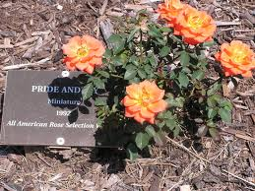

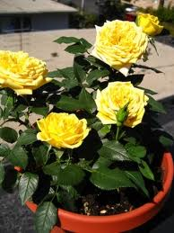
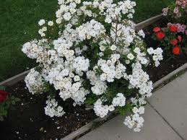

Miniature Roses are Beautiful
Miniature Roses have such a variety of
shape and color
Grow them in Planters
Grow them in Gardens
Grow them in pots
Grow them by sidewalks

Slide 15

Mini-Flora Rose
This is a relatively new class of rose due to its size.
Plants can reach 3 –4 feet in height and blooms can be 3 inches across.
It got its name because
it is bigger than a miniature and not as big as a Floribunda.

Slide 16




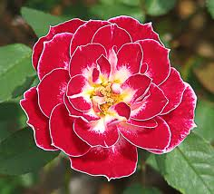

Mini Flora Roses Have Many Shapes and Colors

Slide 17

Floribunda Rose
The Floribunda class of roses typically grow 4 –5 feet high.
They have huge clusters of flowers.
A single cluster from a floribunda can make a bouquet!
These make great plants in the middle of a rose bed.
Floribunda Rose- “Disneyland”

Slide 18
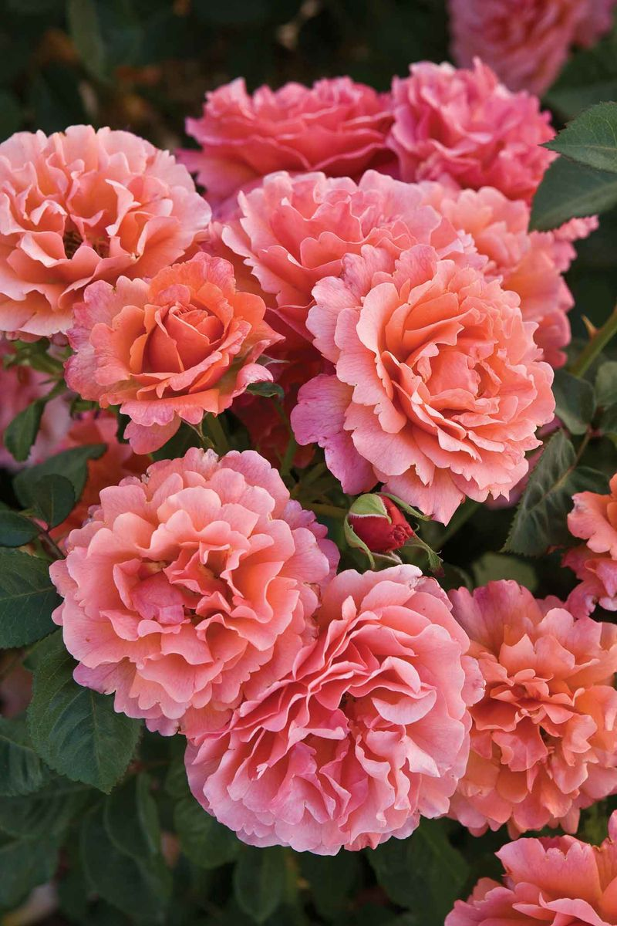

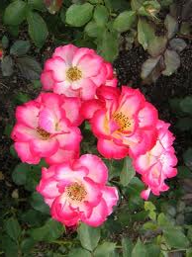

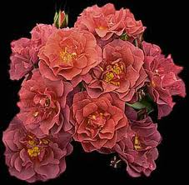
Floribunda’s Naturally Formed Bouquets
Betty Boop
Anne Harkness
Easy Does It
Cinco de Mayo
Sun Flare

Slide 19

Grandiflora
The Grandiflora class of roses can reach 6 feet in height and have long stems with three or four blooms per stem.
They tend to have bigger flowers than the floribundas but fewer of them.
Grandiflora Rose- “Dream Come True”

Slide 20
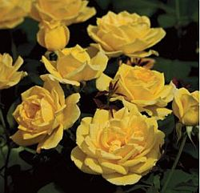


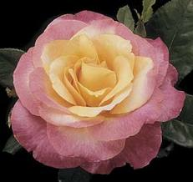

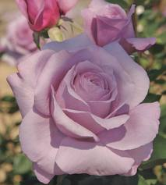
Grandiflora’s are Big and Beautiful
Melody Parfumee
CH-Ching
Cherry Parfait
Heart of Gold
City of Leeds
Sweetness

Slide 21
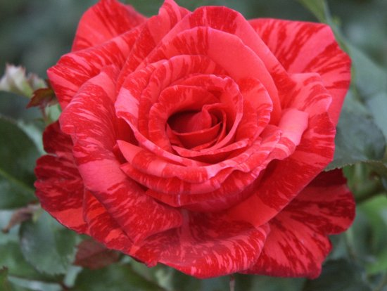
Hybrid Tea Rose
This is what most folks think about when they think of a rose; really long stem with one huge flower at the end.
These plants can reach beyond six feet high and the blooms can be 6 inches across! How is that for being huge?
Hybrid Tea Rose: “Red Intuition”

Slide 22
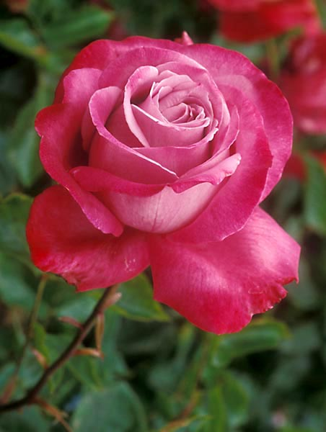
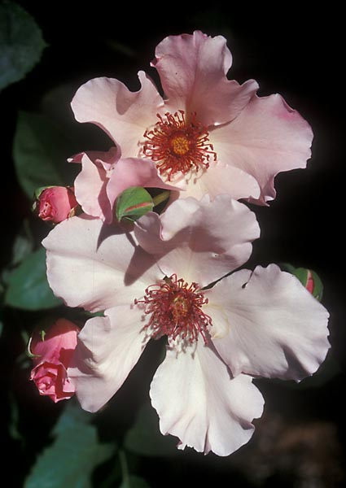
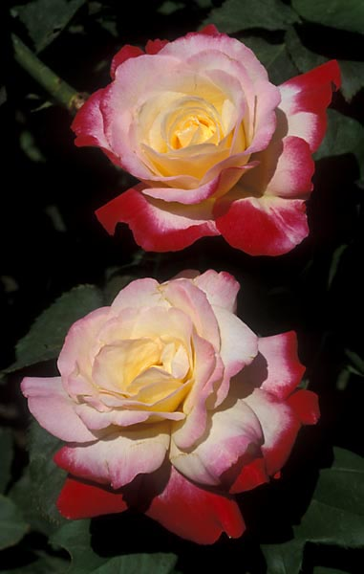
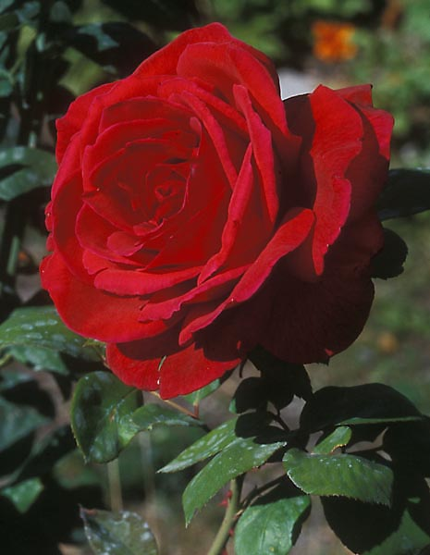
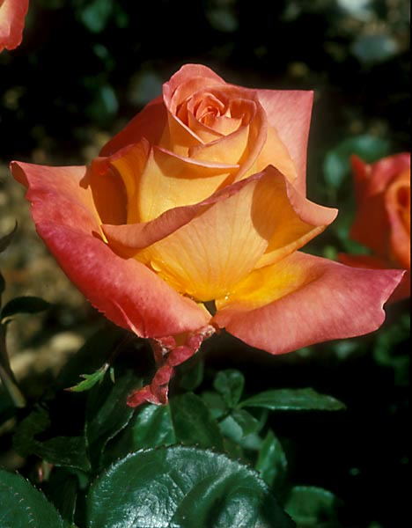
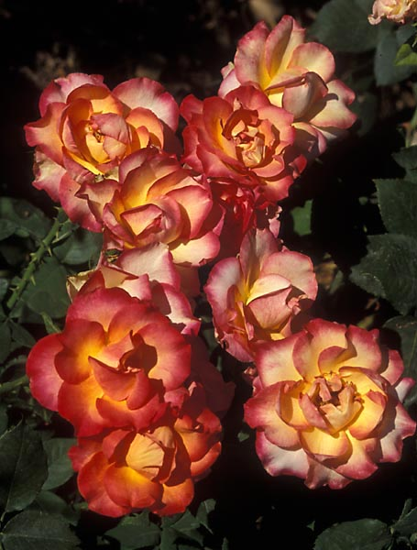
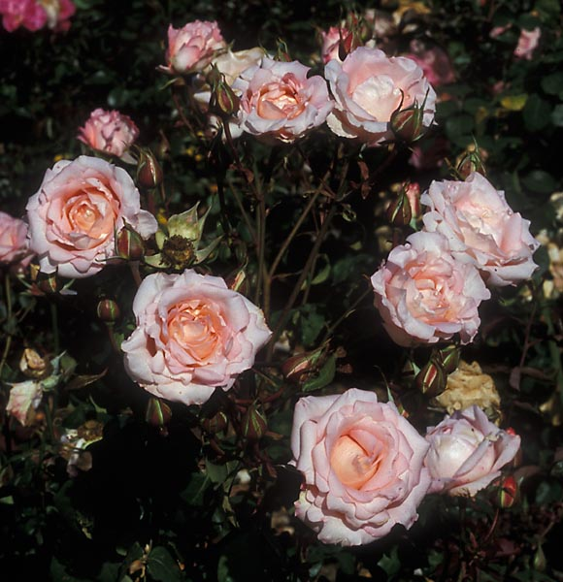
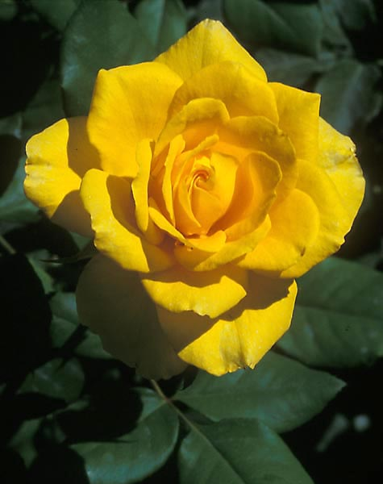
The Ever-Popular Hybrid Tea Comes in Many Colors and Styles of Bloom

Slide 23
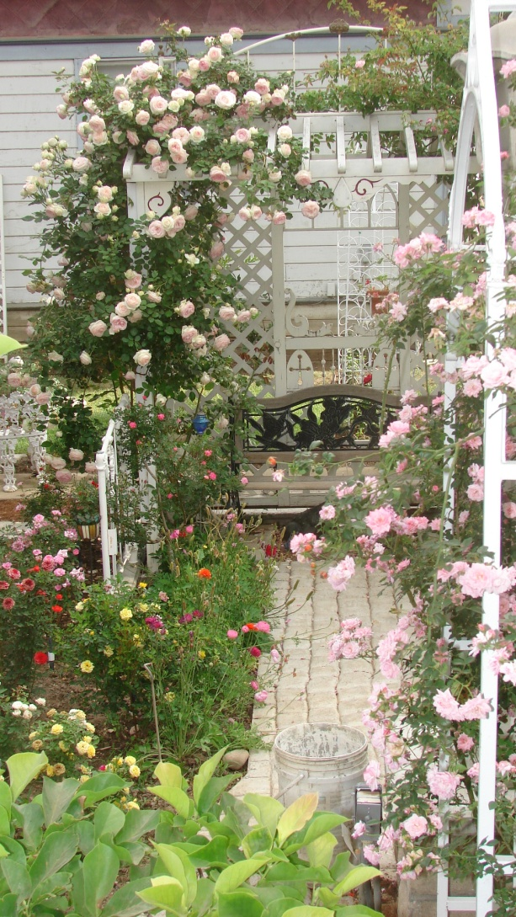
Climbing/ Rambling Roses
These are the roses you see growing on an arbor or up a wall of a building.
Typically, they reach 12 – 15 feet. Some older varieties of climbing roses can grow even longer!
Take a look at what’s next…

Slide 24
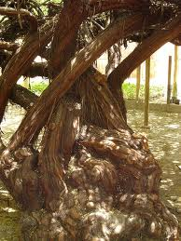
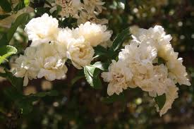
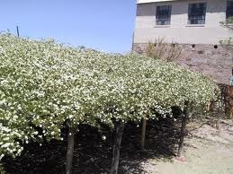

World’s Largest Rose Bush
This “Lady Banks” Rose was brought from Scotland in 1888 and planted in
Tombstone, Arizona
WOW this rose really is BIG!
The base of this rose looks like a tree!
It coves more than 8,000 square feet!

Slide 25
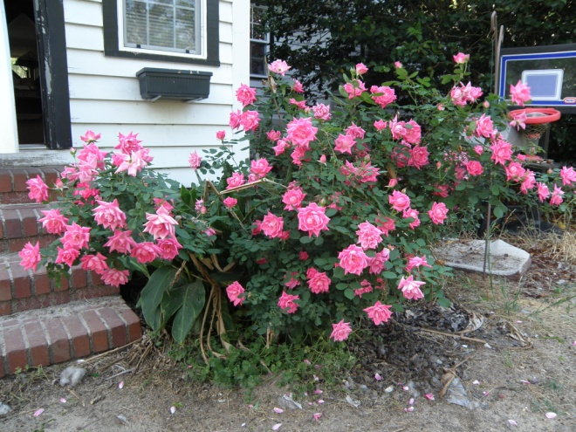
Shrubs
This class of rose
ranges in size from groundcovers to shrubs.
This class can have a wide range of bloom size as well.
Shrub Rose – “Double Pink Knockout”

Slide 26
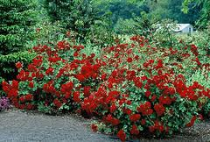
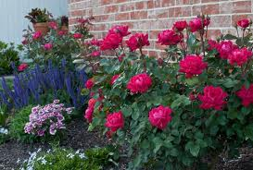
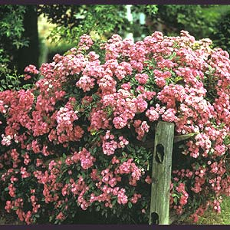
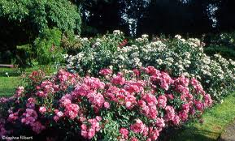
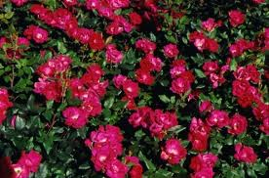
Shrub Roses Have Lots of Blooms
Grow them by a patio
Grow them by a house
Grow them on a fence
Shrub Roses bloom frequently so your rose garden will be filled with color

Slide 27
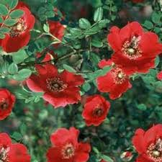
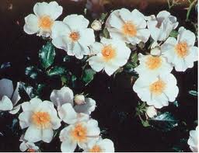

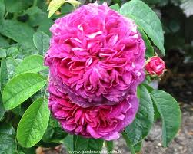
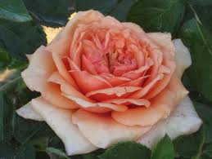
Shrub Rose Blooms Have Variety
Some Shrubs have very simple
5 petal blooms
Some Shrubs have many petals in each bloom

Slide 28

Old Garden Roses (OGRs)
Sometimes called antique roses, these were the roses that helped create the classes above.
They too have a wide range of growth habit and bloom size.
These roses often have an interesting history of where they came from.
For example, the type of rose called the Noisette (nawh- zette) is the only class of rose that was created in North America and it was done in Charleston, South Carolina
Old Garden Rose: “Paul Neyron”

Slide 29
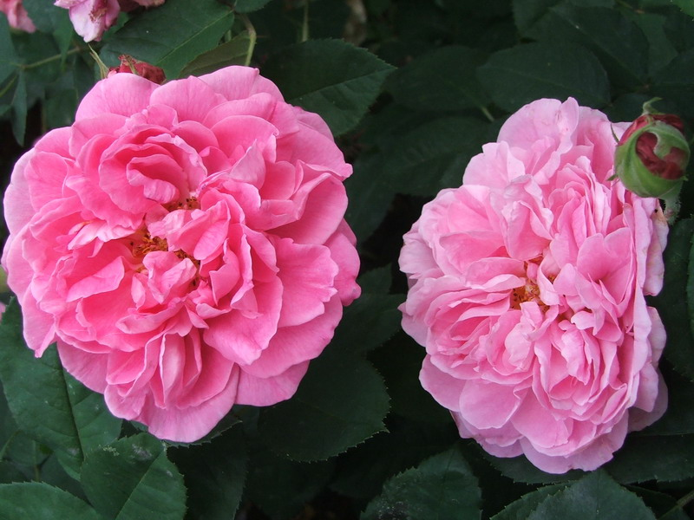
The Old Garden Class of Roses is often Highly Fragrant

Slide 30
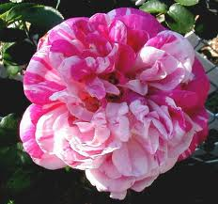
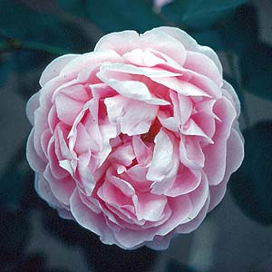
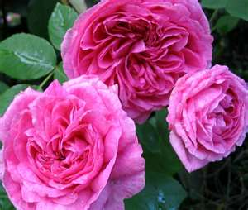


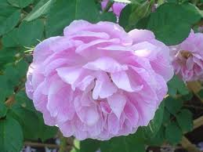

This Class of Roses usually blooms only in the spring or early summer

Slide 31
What Else is There to Know About Roses?
There are many more wonderful and interesting things to learn about roses.
In the next part of today’s lesson we are going to look at the basic bloom forms.
Let’s Begin Part 2

Slide 32
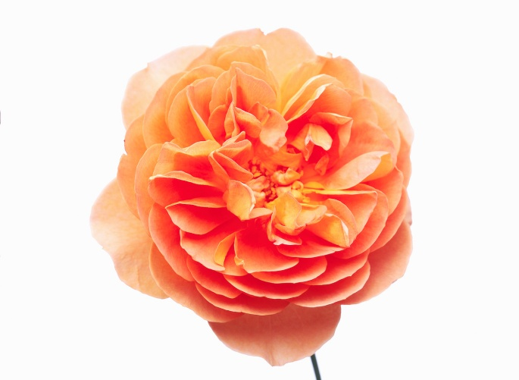
Bloom Forms of Roses
Today, we are going to look at the following bloom forms:
5 Petal Shaped Rose Bloom
Pointed Shaped Bloom
Rosette Shaped Bloom
Quartered Shaped Bloom
Urn or Balloon Shaped Bloom
Round Shaped Bloom

Slide 33
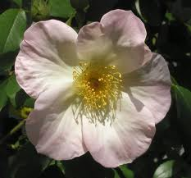
5 Petal Shaped Roses
All wild roses have five petals and five modified leaves called sepals.
More roses than the “wild ones” have five petals.
Let’s take a look at a few of them…
5 Petal Rose- “Sally Holmes”

Slide 34
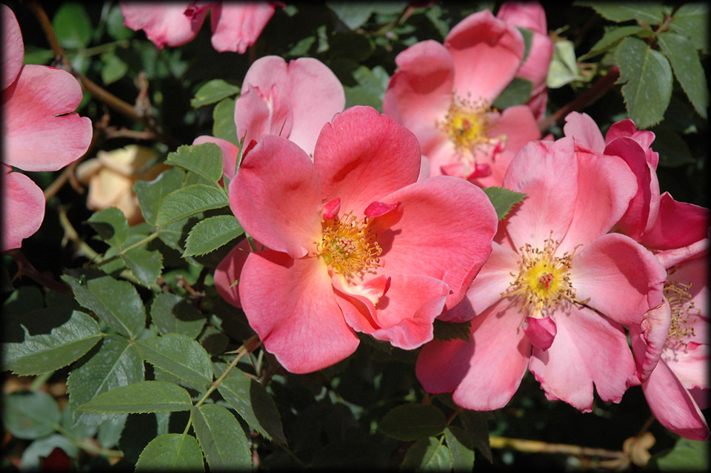
Summer Wind

Slide 35

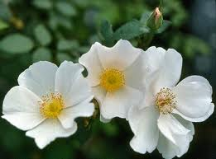
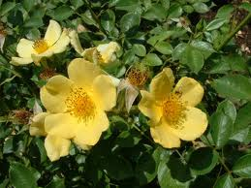
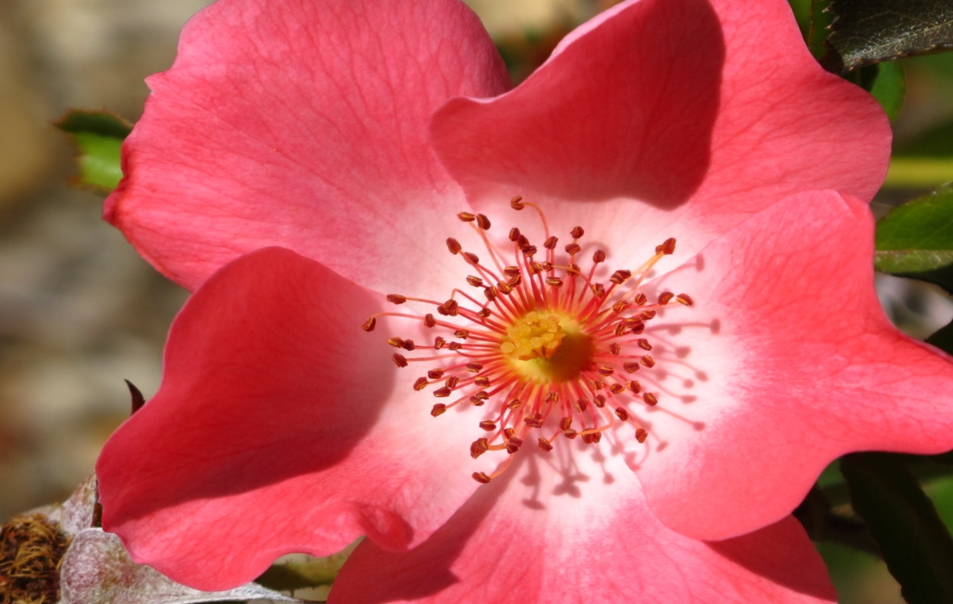
“Sharon’s Delight” is a white five petal Miniature
“Baby Love” is a soft yellow five petal shrub rose

Slide 36

Pointed Shaped Roses
Pointed-form roses are mostly found in the hybrid tea classification.
Pointed Shaped Rose-
Hybrid Tea“Gemini”

Slide 37

Notice how tightly the petals swirl around the pointed center

Slide 38







These Blooms are Great!
Get the “Point”?

Slide 39

Rosette Shaped Roses
These roses have a great many petals that often grow in an uneven pattern.
When the blooms are partially open they sometimes look like balls.
Rosette Shaped Rose- “Evelyn”

Slide 40






Rosettes are Really Ruffled!

Slide 41

Quartered Shaped Roses
Quartered-form roses have four sections of petals rotating around the four different centers.
Quartered Shaped Rose-
“Rose du Roi”

Slide 42





A Small Sample of Quartered Blooms

Slide 43
Round Shaped Roses
Round Shaped Roses
are small round blooms
with masses of even petals.
They are sort of like
A Cheer Leader’s
Pom-Pons

Slide 44






These Happy Little Rose Blooms Can Really Cheer up Any Garden!

Slide 45

Whatever Their Class or Shape of Bloom…
Roses Bring Beauty to Our World !
We Hope You Had a Good Time Learning About Roses

Slide 46
Kidz N’ Roses Wishes to Thank:
Mary Moody, Peter Harkness, “The Illustrated Encyclopedia of Roses”
Jay and Pam Hiers, “Trick or Treat in the Rose Garden”
Types Of Roses A complete guide to rose selection
http://www.rose-works.com/types-of-roses.html
The American Rose Society
Bob Bauer-Photos

