Slide 1
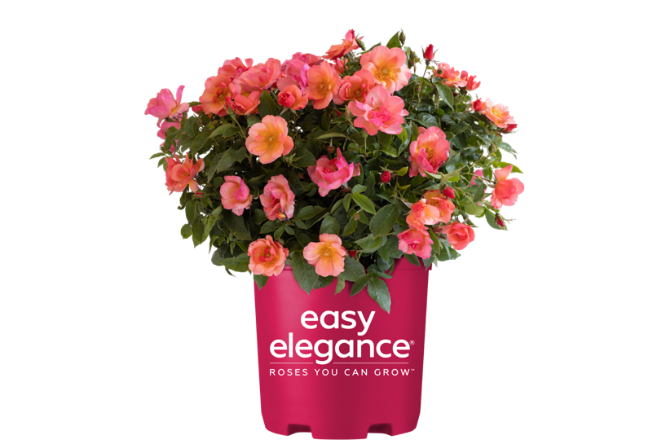
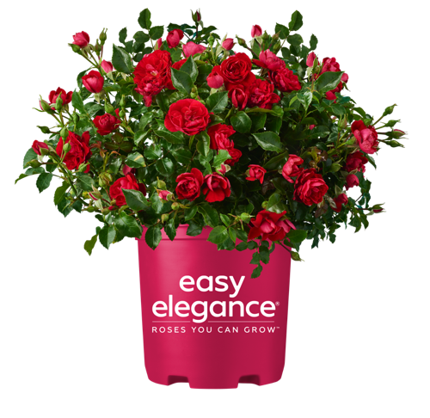
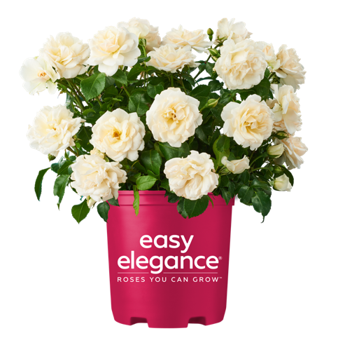
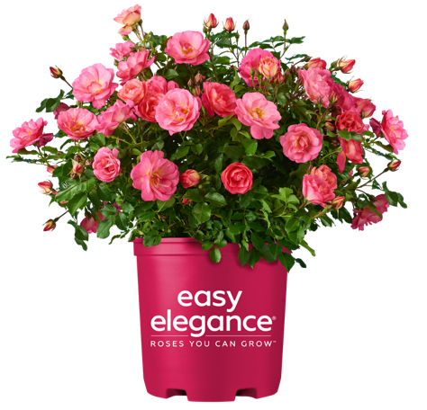
The History of Easy Elegance Roses
Debbie Lonnee, Product Development Manager, Bailey Nurseries

Slide 2
In 1991, rosarian Jerry Twoomey approached the Bailey family and recommended they start rose breeding. Jerry was hired as a consultant. From Manitoba, Canada and had worked for Devor Nursery. Jerry recommended that we hire Ping Lim.

Slide 3
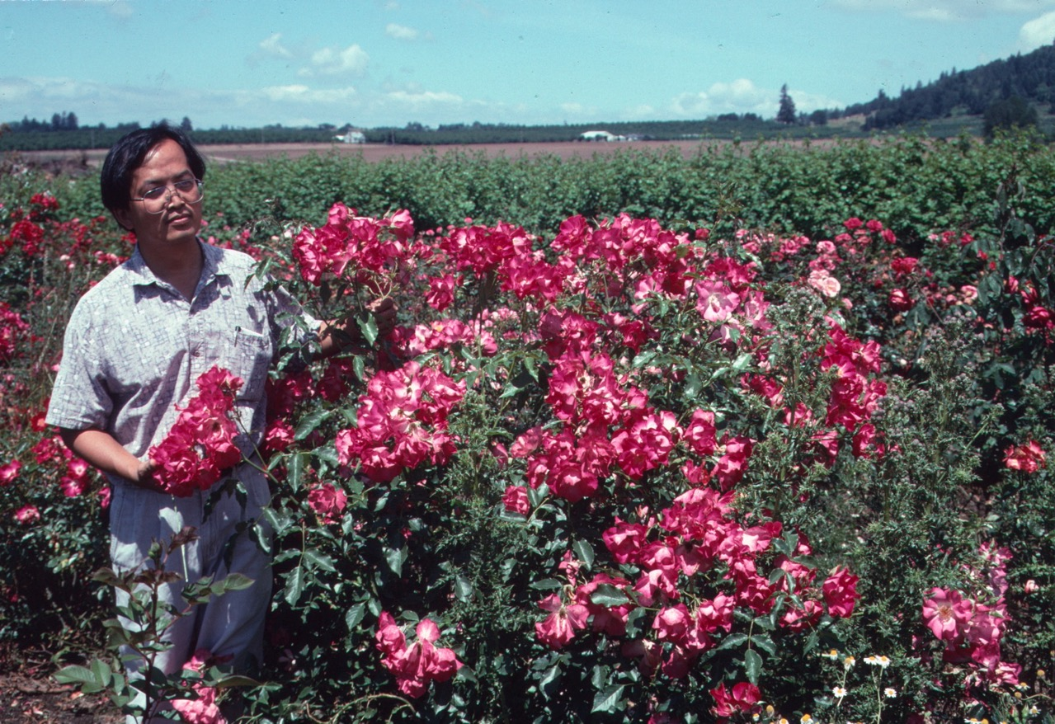
In 1992, breeder Ping Lim, from Taiwan, was hired as a full time rose breeder working at our Yamhill, Oregon farm.

Slide 4
Initially, Jerry and Ping did a lot of crossing using hybrid teas.
But quickly, breeding goals emerged that pivoted the program in a different direction.
Those goals included: own root roses, zone 4 hardy (Bailey is based in cold Minnesota!), disease resistant, reblooming, good production plants, good garden performers with no need to spray and no winter cover (dieback/crown-hardy types)
Jerry only stayed on as a consultant for a couple of years.
In the early 2000’s plans were made to develop a rose brand called Easy Elegance. This was in the early days of brands . . . . Do you all remember Flower Carpet rose?
Ping started by making 25,000-30,000 crosses per year and by the end of his breeding program was making 50,000 crosses per year=250,000 seedlings!
All initial testing/trialing was done either in Oregon, or at Leyton Woolf farms (production trials) in Arizona.

Slide 5
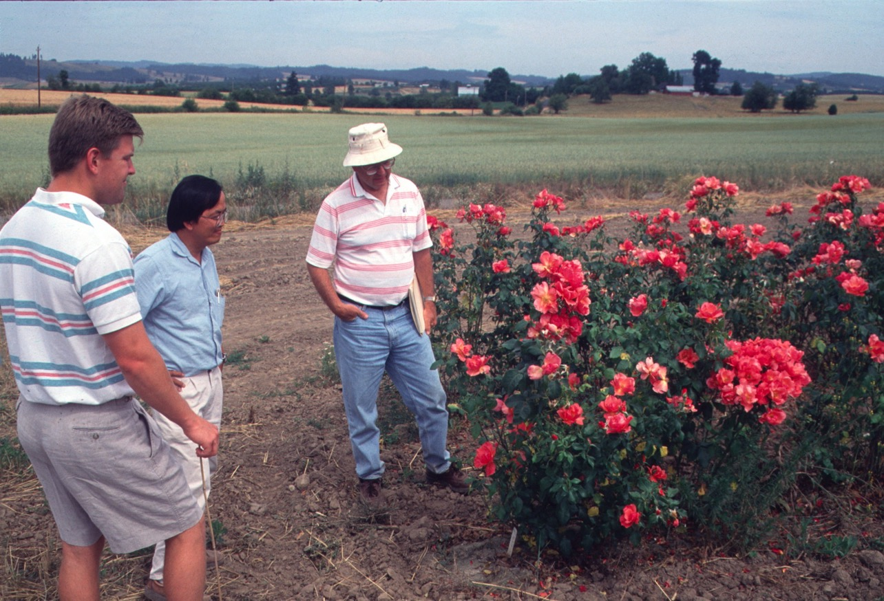
Throughout the 90’s and into the 2000’s, Bailey staff from Minnesota made the trek to Oregon to walk the field rows of rose seedlings with Ping. On the right is Don Selinger, manager of Planning and Administration and one of the driving forces behind the rose program. In the middle is Ping, on the left is Dan Bailey, sales manager.

Slide 6
Seed was collected and germinated in greenhouses in the propagation area. Ping inoculated all seedlings with strains of black spot to eliminate susceptible varieties.

Slide 7
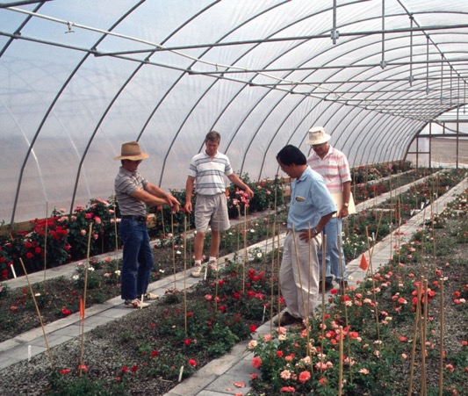
More evaluators! Even I went out twice a year. June was the most important trip of the year for rose evaluation and selection.

Slide 8
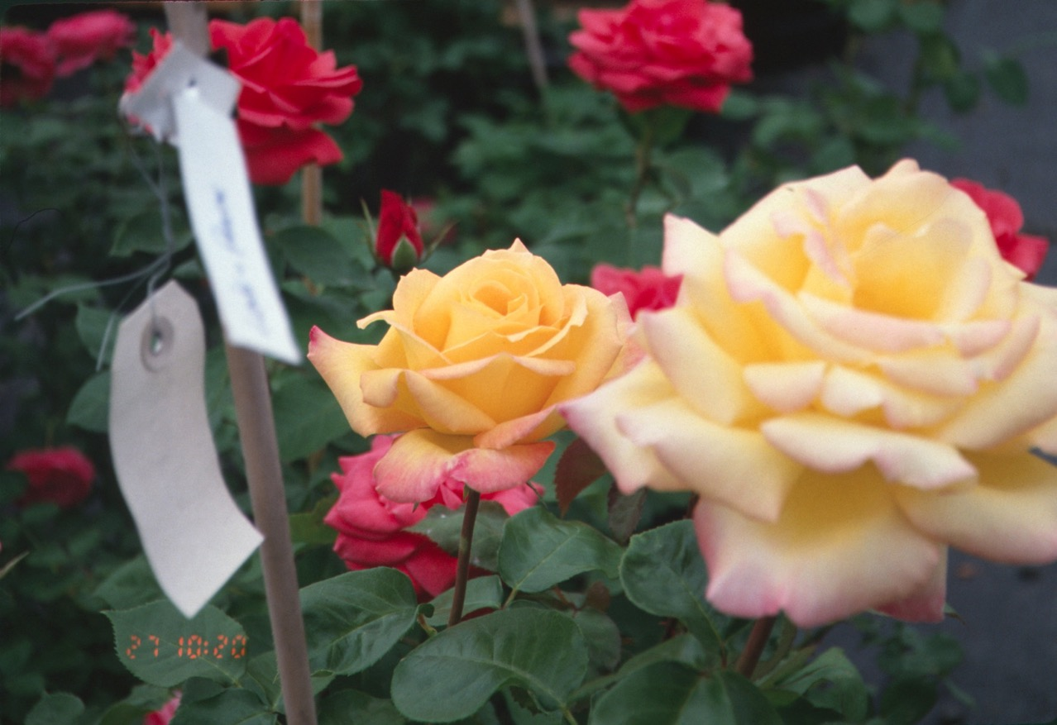
In 2002, Ping and Jerry’s rose Love & Peace won the AARS award!

Slide 9
Roses at Bailey Nurseries . . .
In the ‘90’s Bailey grew an extensive list of roses, both bareroot and container as well as a ‘bud and bloom’ program (forced for Mother’s Day sales).
This included Austin, Buck, Explorer, Parkland, rugosa, garden roses (hybrid teas, grandiflora and floribunda)
Easy Elegance was launched in 2003. The first rose catalog published for the year included only Macy’s Pride and My Hero. The variety list grew substantially that year and a second catalog was published introducing many more EE varieties

Slide 10
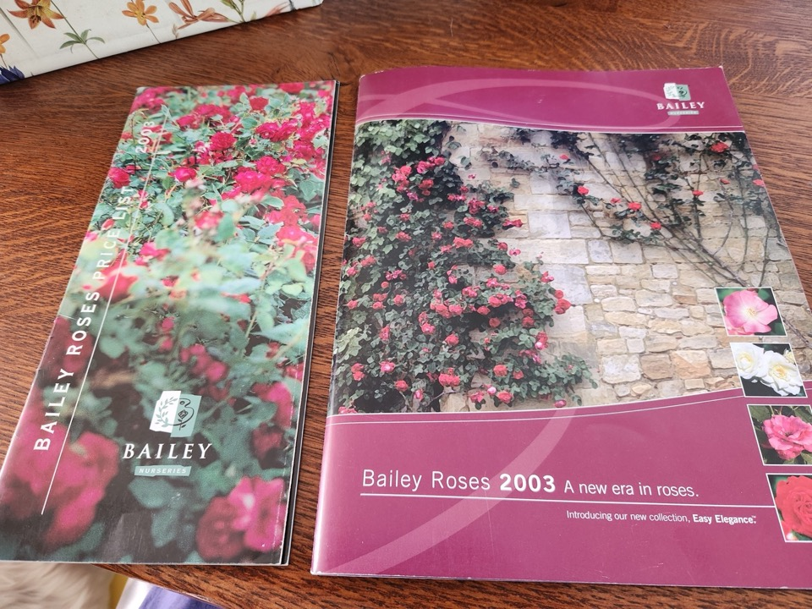

Slide 11
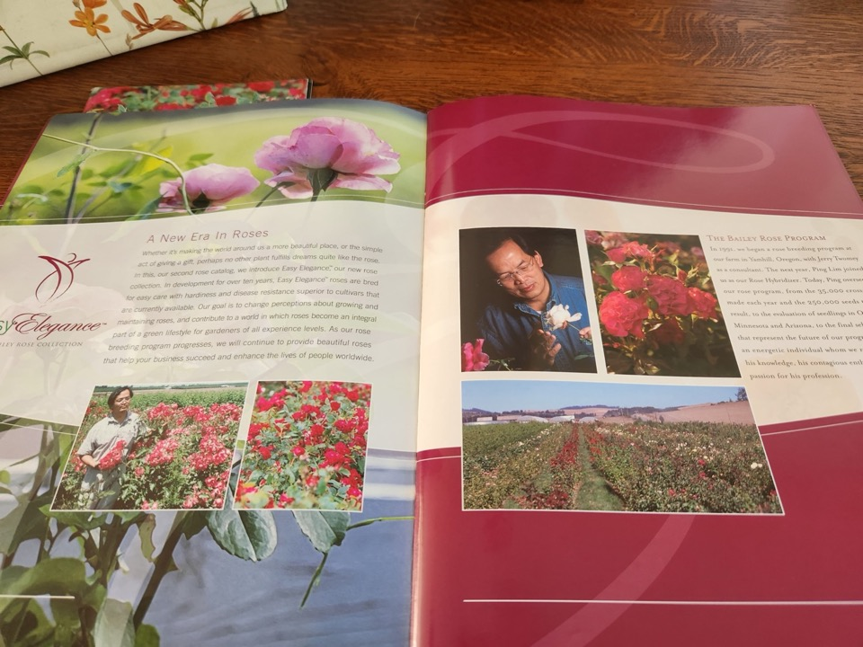

Slide 12
Easy Elegance® launch at Bailey Nursery . . . .
Marketing decided to ‘categorize’ the Easy Elegance rose line, into four series:
Lifestyle Garden series – hardy roses for trouble-free performance. Easy to plant, easy to grow, easy to maintain.
Garden Jubilee series – Easy growing roses that add bursts of color to landscapes. Many of the blooms in this series will be bi-colored for even more impact.
Garden Art series – Combines the best traits of a Hybrid Tea bloom with the vigor only an Easy Elegance rose can offer for a work of art to treasure for years.
Garden Path series – smaller, low-growing roses that add color to compact area, along pathways or borders.

Slide 13
Original Easy Elegance® introductions, within their series . . .
Garden Art: Grandmas Blessing, Macy’s Pride, Yellow Submarine, Salmon Impressionist, Last Tango, Orange Impressionist
Garden Jubilee: Firecracker, Golden Eye, Funny Face, Hot Wonder, Sierra Skye
Garden Path: Little Mischief, Mystic Fairy, Pink Gnome, Sunrise, Sunset
Lifestyle Garden: My Hero, Tahitian Moon

Slide 14
2006 additions to the line . . . .
Paint the Town
Firecracker
Island Dancer
Centennial
Kiss Me
Great Wall

Slide 15
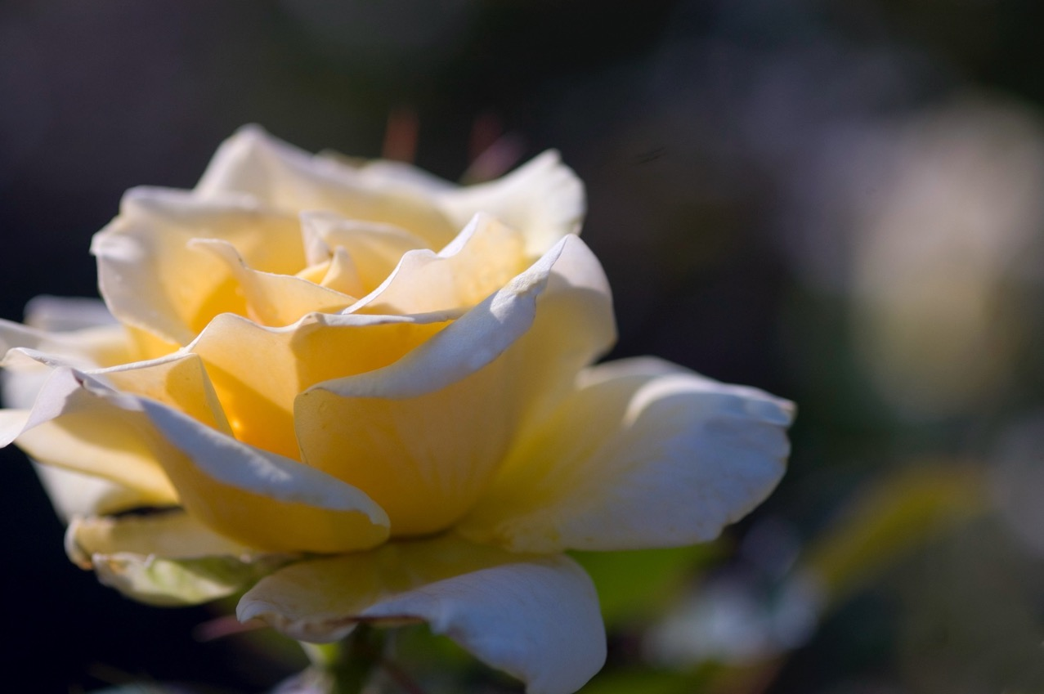

Slide 16
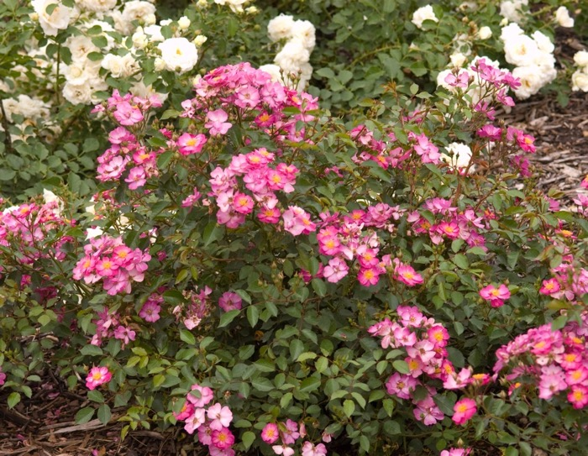
Left: Centennial Right: DayDream

Slide 17
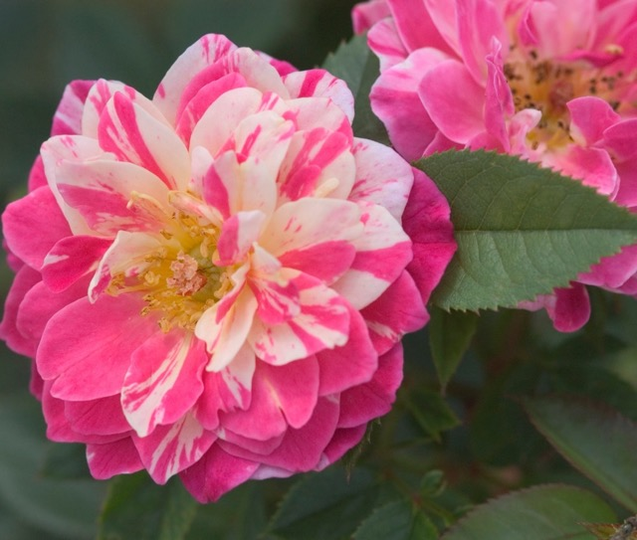
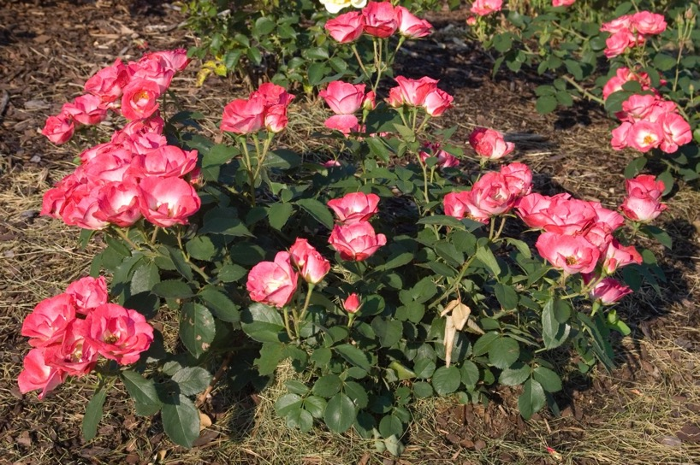
Left: Fiesta Right: Firecracker

Slide 18
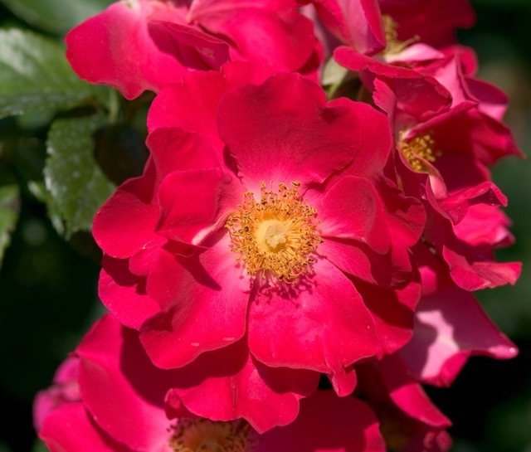
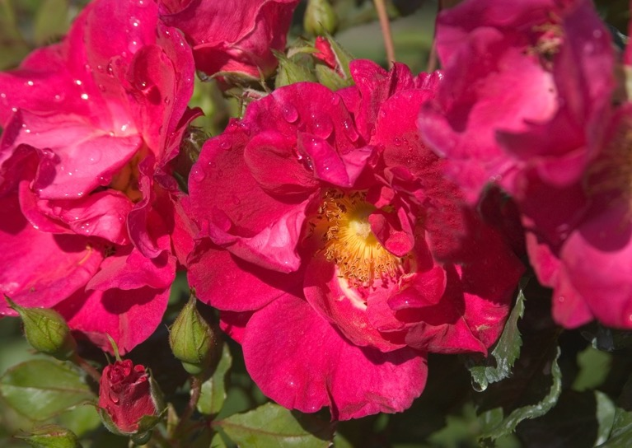
Left: GoldenEye Right: GreatWall

Slide 19
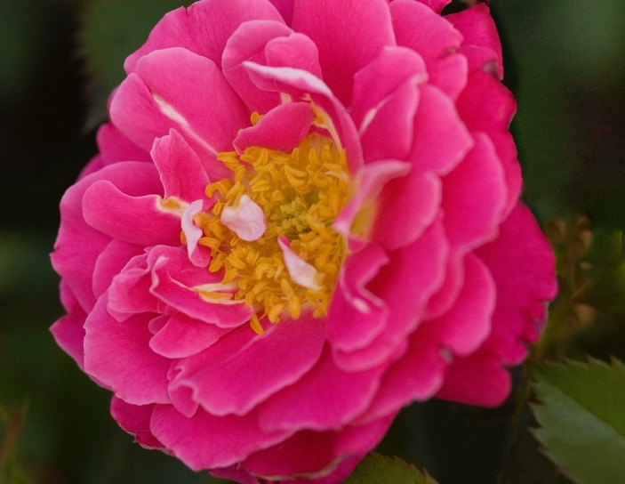
Left: Hot Wonder Right: Island Dancer

Slide 20
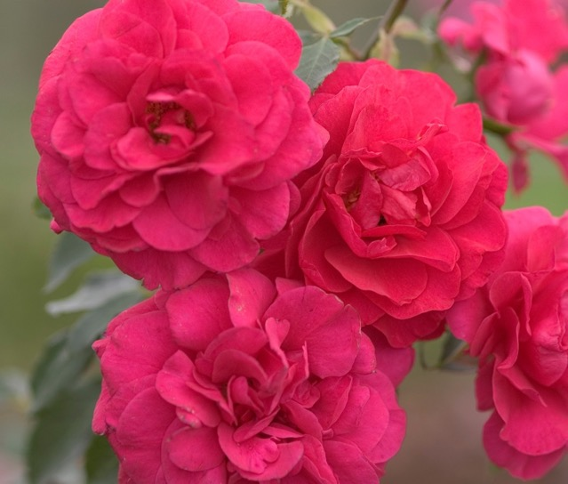
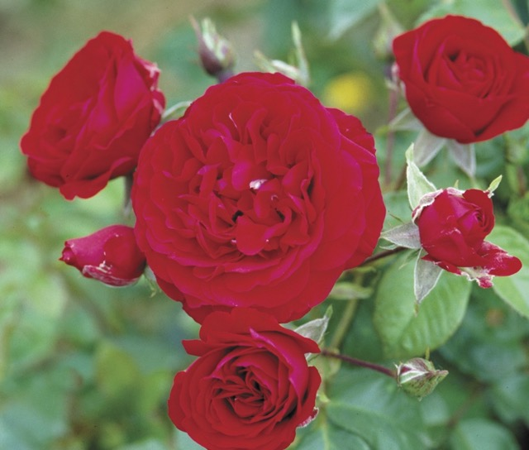
Left: Last Tango Right: My Hero

Slide 21
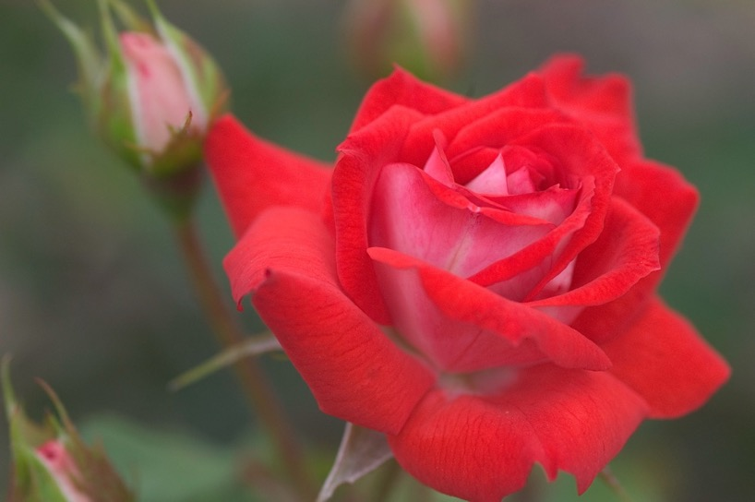
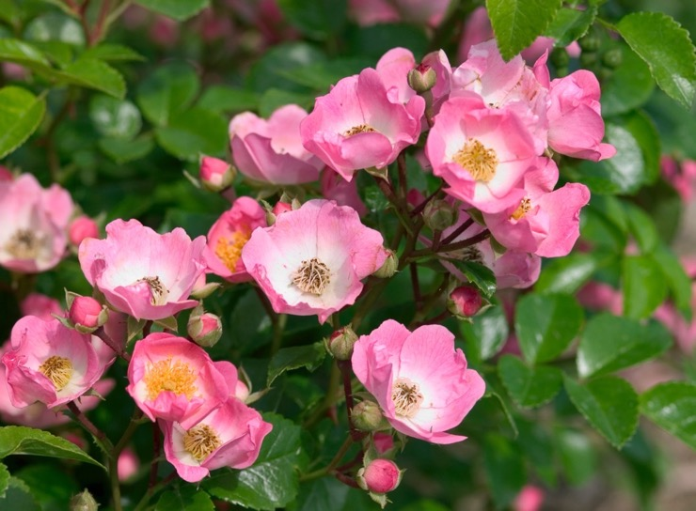
Left: Orange Impressionist Right: Right Gnome

Slide 22
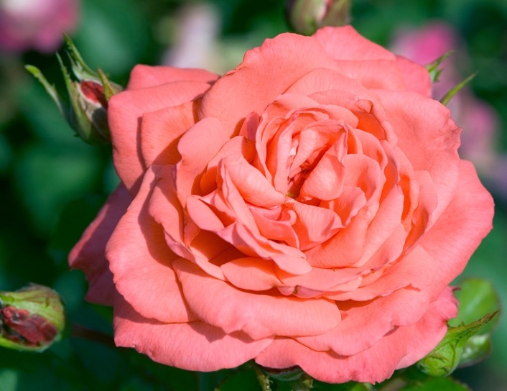
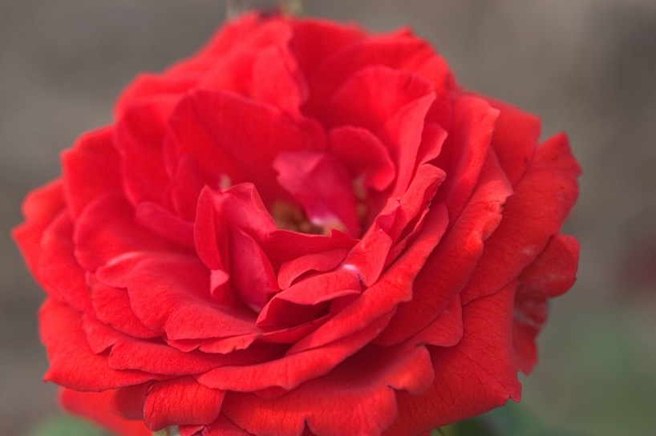
Left: Salmon Impressionist Right: Sierra Skye

Slide 23
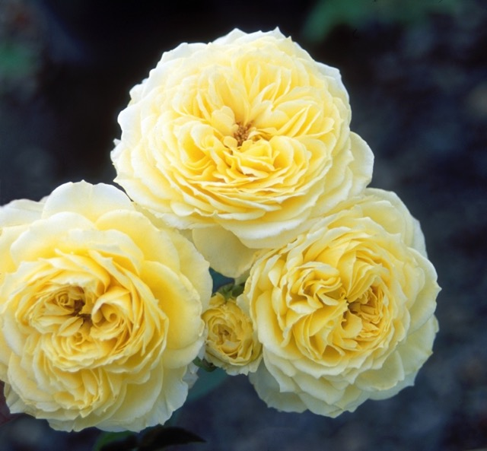
Tahitian Moon

Slide 24
In 2005, DayDream rose won the AARS award!

Slide 25
Lessons learned . . .
We made some mistakes early – we did not test for hardiness thoroughly enough and put wrong zones on plants and that hurt the launch.
The economic recession from 2008-2011 was really hard on the rose market, we dropped many varieties from our list. KnockOut was king!
We now test any future Easy Elegance® varieties in four Bailey locations: Minnesota, Oregon, Illinois and Georgia
Our focus has become more northern oriented with hardiness being a very strong goal.
The launch of Endless Summer® hydrangea brand in 2004 catapulted us into the huge world of plant brands.

Slide 26
A network of growers, both in North America and internationally are licensed to grow and sell Easy Elegance®

Slide 27
Breeding
We stopped breeding in Oregon with Ping late in 2008 (the recession had a lot to do with it). Ping is now breeding at Altmans in California. His favorite Easy Elegance® roses (and he is still a huge champion for the brand) are Kiss Me, Sweet Fragrant, Funny Face, Sunrise, Sunset
We now work with both private breeders as well as land grant universities. We are looking for a purple hardy shrub rose as well as better whites and yellows.
We have a number of older varieties where the patent is running out within 5-6 years and we will be retiring those varieties and adding in new fresh varieties

Slide 28
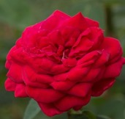
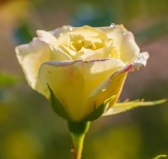
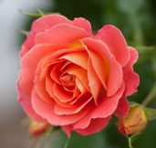
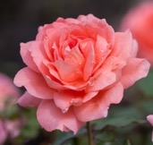
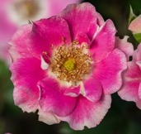
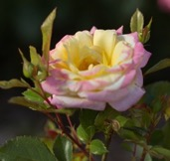
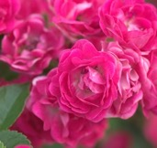
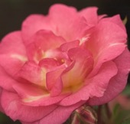
TOP 10 EASY ELEGANCE® ROSES
#1 Mystic Fairy®
#2 Champagne Wishes
#3 Kashmir
#4 High Voltage
#5 Coral Cove
#6 Sweet Fragrance
#7 Funny Face™
#8 Music Box
#9 Little Mischief
#10 Sunrise Sunset
*Sales based on Bailey Nurseries and Network Growers from 1st half of 2024

Slide 29
All the Rage
Rosa ‘BAIrage’ PP19,945
Produces delightful apricot-colored blossoms with yellow centers.
Long bloom period highlights range of colors.
Disease resistant rose with clean foliage to keep the plant looking fresh.
Height | Width | Exposure | Color
3-5’ | 2-4.5’ | Full Sun | Apricot Blend
USDA Hardiness Zone | AHS Heat Zone | Flower Form and Size
4-9 | 8 | Semi-Double, 3-4”

Slide 30
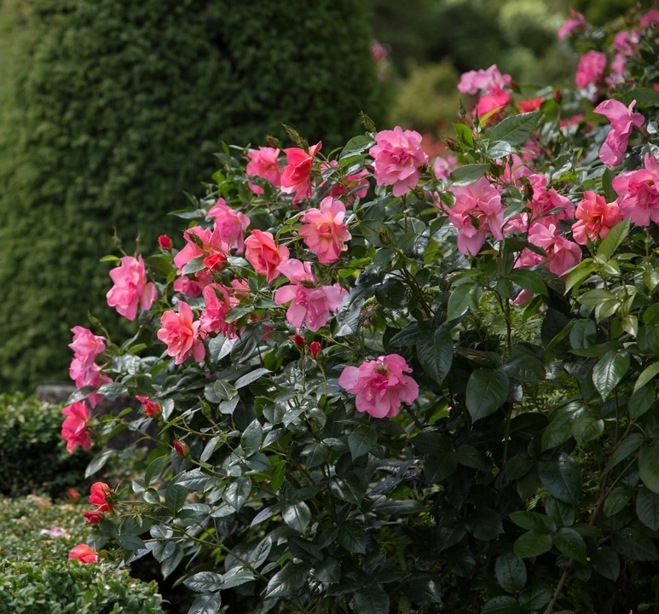
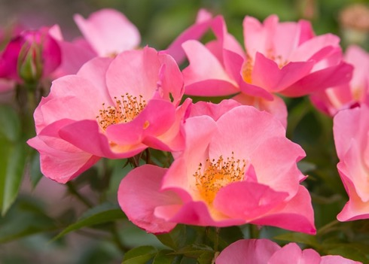
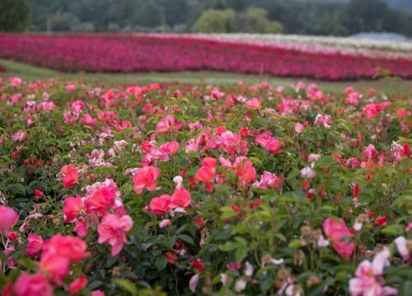

Slide 31
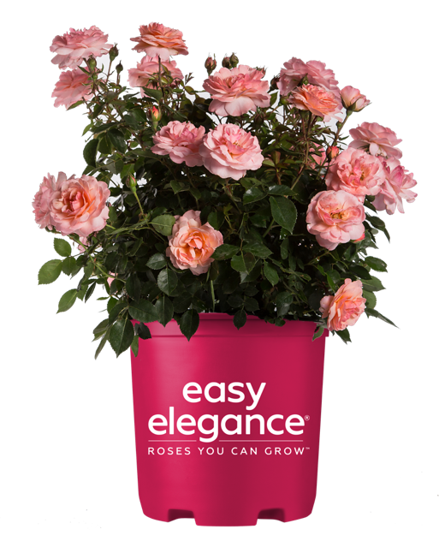
Calypso
Rosa ‘BAIypso’
Features apricot flowers that rebloom to produce consistent color.
Glossy foliage is disease resistant and remains attractive all summer.
Compact size is perfect for a garden or foundational planting.
Height | Width | Exposure | Color
2’ | 2’ | Full Sun | Apricot Blend
USDA Hardiness Zone | AHS Heat Zone | Flower Form and Size
5-9 | 9 | Double, 2.5”

Slide 32
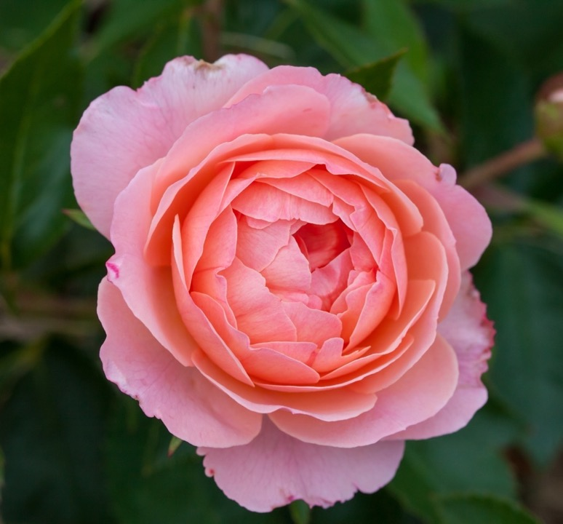
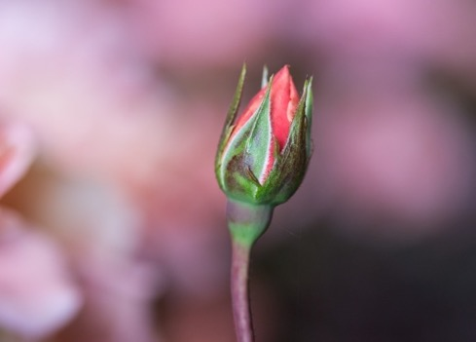
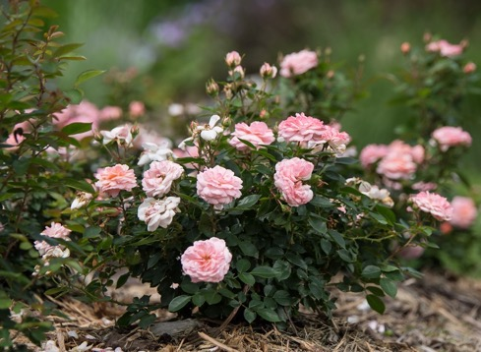

Slide 33
Champagne Wishes
Rosa ‘BAIcham’
Clusters of apricot buds open to antique white blooms.
Flowers rebloom of bring consistent color to the garden.
Medium green foliage contrasts beautifully with the colorful blooms.
Height | Width | Exposure | Color
3-4’ | 2-3’ | Full Sun | White
USDA Hardiness Zone | AHS Heat Zone | Flower Form and Size
4-7 | 7 | Full, 3"

Slide 34
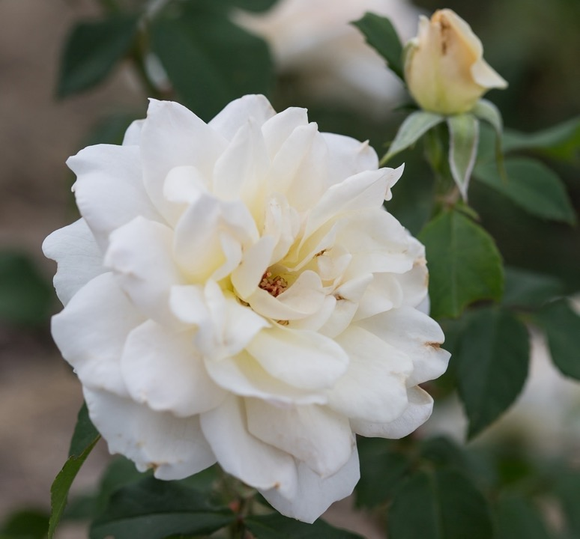
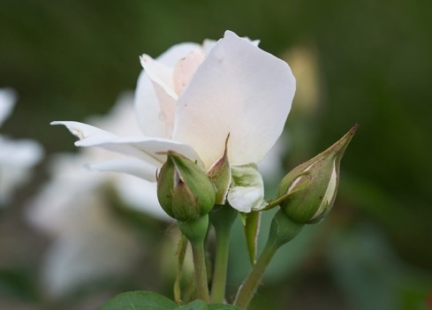
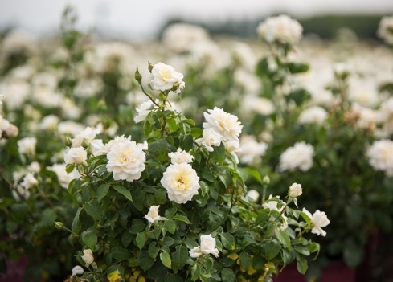

Slide 35
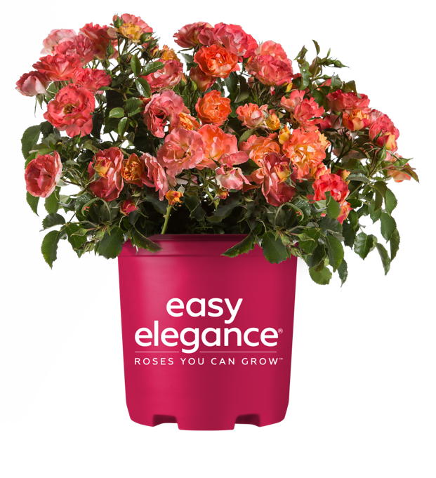
Coral Cove
Rosa ‘BAIove’
Double blooms are dark pink on the outside, orange and yellow on inside.
Small, rounded form is perfect for walkways or a garden path.
Named the 2014 Best Shrub Rose by the Portland Rose Society.
Height | Width | Exposure | Color
2-3.5’ | 2-4.5’ | Full Sun | Orange-Pink Blend
USDA Hardiness Zone | AHS Heat Zone | Flower Form and Size
4-9 | 8 | Double, 3"

Slide 36
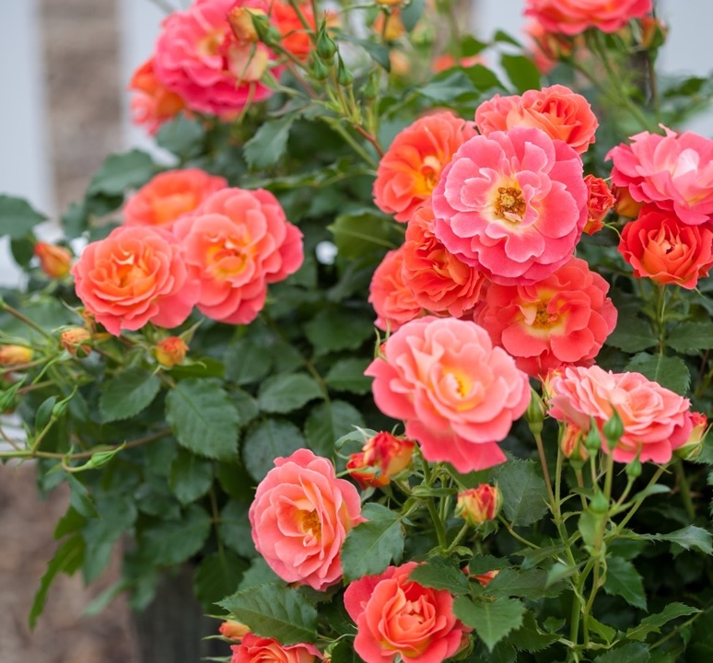
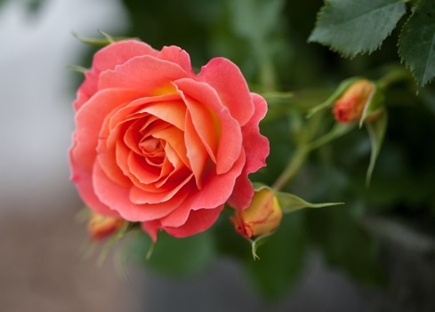
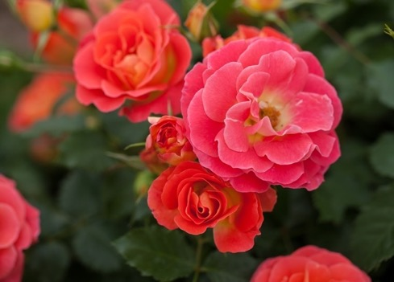

Slide 37
High Voltage
Rosa ‘BAIage’
Beautiful clusters of double yellow blooms on sturdy stems.
Perfect plant for the back of a border or an accent.
Named the Best Shrub rose in 2010 by the Portland Rose Society.
Height | Width | Exposure | Color
4-5’ | 2-4’ | Full Sun | Medium Yellow
USDA Hardiness Zone | AHS Heat Zone | Flower Form and Size
4-9 | 8 | Double, 2-3"

Slide 38
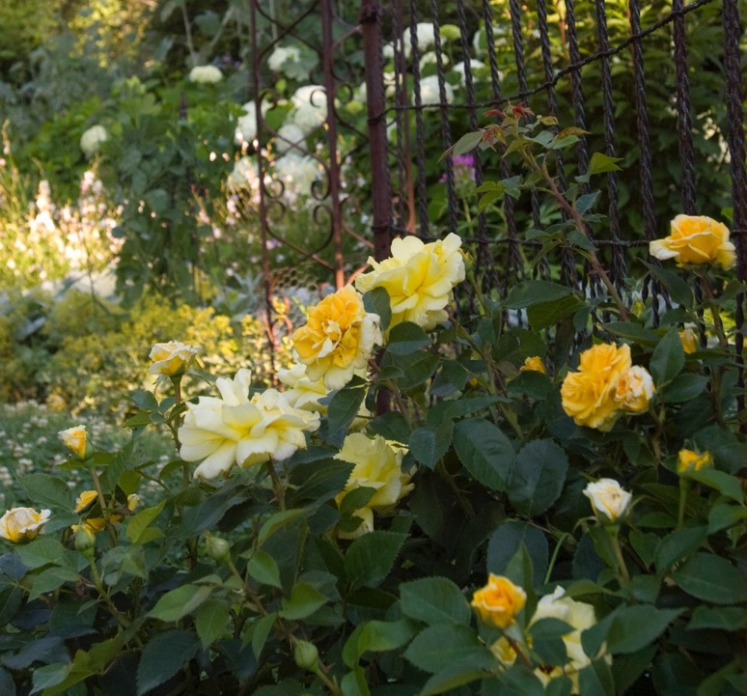
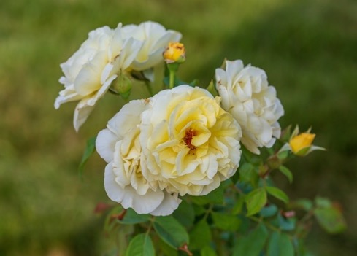

Slide 39
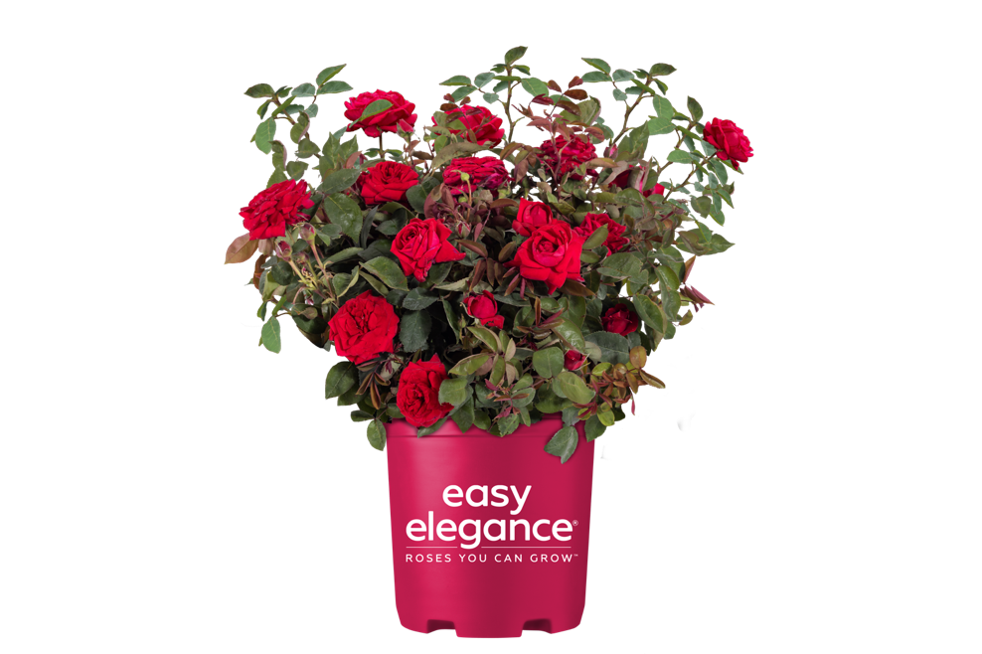
Kashmir
Rosa ‘BAIage’
Flowers resemble a hybrid tea rose, but the plant is low maintenance
Velvet red blossoms are perfect in floral arrangements
Rounded, symmetrical habit is ideal for a bold accent
Height | Width | Exposure | Color
3-4’ | 2-3’ | Full Sun | Red
USDA Hardiness Zone | AHS Heat Zone | Flower Form and Size
4-9 | 8 | Very Full, 3"

Slide 40
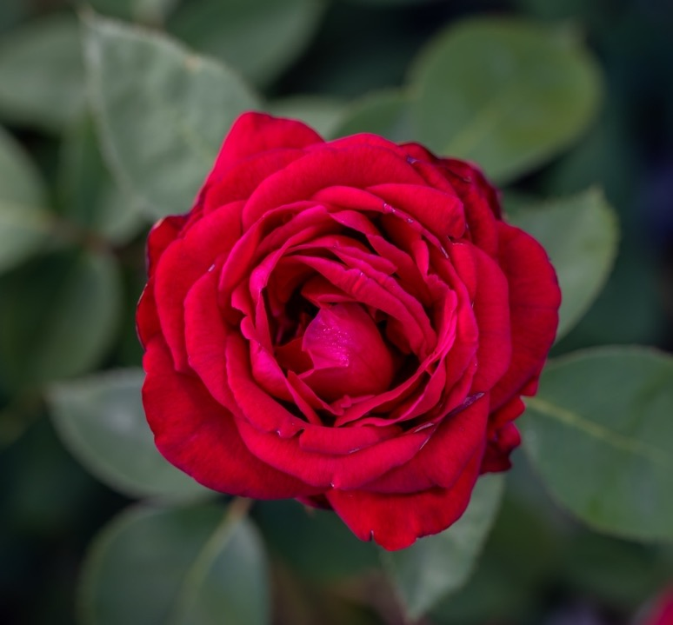

Slide 41
Little Mischief
Rosa ‘BAIief’ PP17,196
Offers consistent color, hardiness, and disease resistance.
New blooms are deep pink, then become light pink as they age.
Excellent low growing plant in a border, hedge or container.
Height | Width | Exposure | Color
2-3’ | 2-4’ | Full Sun | Deep Pink
USDA Hardiness Zone | AHS Heat Zone | Flower Form and Size
4-9 | 8 | Double, 1"

Slide 43
Music Box
Rosa ‘BAIbox’
Double blossoms feature creamy yellow centers and pink blends.
Glossy foliage contrasts beautifully with the delicate flowers.
Has excellent disease resistance and is a perfect accent in the garden.
Height | Width | Exposure | Color
3-5.5’ | 3-4.5’ | Full Sun | Yellow Blend
USDA Hardiness Zone | AHS Heat Zone | Flower Form and Size
4-9 | 9 | Double, 2"

Slide 45
My Girl
Rosa ‘BAIgirl’ PP19,952
Adorable pink flowers are held upright in numerous clusters.
Lush green foliage is highly resistant to black spot.
Compact, upright habit that looks good in any border.
Height | Width | Exposure | Color
3-5’ | 3.5-5’ | Full Sun | Deep Pink
USDA Hardiness Zone | AHS Heat Zone | Flower Form and Size
4-9 | 8 | Full, 2-3"

Slide 47
Mystic Fairy®
Rosa ‘BAIfairy’ PP16,131
Brilliant red blooms emerge from massive clusters all summer long.
New growth is glossy red and matures to glossy dark green leaves.
Resistant to blackspot, mildew, and looks perfect in a border planting.
Height | Width | Exposure | Color
3-4’ | 3-4’ | Full Sun | Red Blend
USDA Hardiness Zone | AHS Heat Zone | Flower Form and Size
4-9 | 8 | Full, 2"

Slide 49
Oscar Peterson™
Rosa ‘AAC333’
Produces sprays of semi-double white flowers on a hardy plant.
Disease resistant foliage is green and contrasts nicely with blooms.
Forms bright orange hips that can be made into jams and jellies.
Height | Width | Exposure | Color
2-4’ | 2-3’ | Full Sun | Creamy White
USDA Hardiness Zone | AHS Heat Zone | Flower Form and Size
3-8 | 8 | Semi-Double, 3”

Slide 51
Paint the Town
Rosa ‘BAItown’ PP18,060
Stunning red blooms carpet this rose all season long.
Glossy foliage is disease resistant, and contrasts nicely with flowers.
Features a spreading to mounded shape, perfect for containers and borders.
Height | Width | Exposure | Color
2-3’ | 2-4’ | Full Sun | Medium Red
USDA Hardiness Zone | AHS Heat Zone | Flower Form and Size
4-9 | 9 | Double, 3.5’’

Slide 53
Pinktopia
Rosa ‘BAImas’
Clusters of reblooming pink flowers cover this plant.
Lustrous foliage is dark green and disease resistant.
Compact habit that is excellent for an accent or hedge.
Height | Width | Exposure | Color
4’ | 3’ | Full Sun | Medium Pink
USDA Hardiness Zone | AHS Heat Zone | Flower Form and Size
4-9 | 8 | Semi-Double, 3’’

Slide 55
Screaming Neon Red™
Rosa ‘BAIneon’
Boasts intense color and superior performance.
Red blooms contrast beautifully with the disease-resistant foliage.
Compact shape is perfect for an accent or mass planting.
Height | Width | Exposure | Color
3-4’ | 2-3’ | Full Sun | Medium Red
USDA Hardiness Zone | AHS Heat Zone | Flower Form and Size
4-9 | 8 | Single, 2-2.5”

Slide 57
Sunrise Sunset
Rosa ‘BAIset’ PP16,770
Multicolored blend of bright fuchsia-pink blooms with apricot centers
Everblooming habit contrasts beautifully with disease resistant foliage
Wonderful ground cover for cool and warm climates
Height | Width | Exposure | Color
3-6’ | 4-7’ | Full Sun | Pink Blend
USDA Hardiness Zone | AHS Heat Zone | Flower Form and Size
4-9 | 9 | Semi-Double, 2-2.5”

Slide 59
Super Hero
Rosa ‘BAIsuhe’ PP20,486
Durable low maintenance rose with clusters of red blossoms.
Medium to dark foliage is clean and disease resistant.
Compact shrub for a border or foundation in cool and warm regions.
Height | Width | Exposure | Color
3-6’ | 3-6’ | Full Sun | Red
USDA Hardiness Zone | AHS Heat Zone | Flower Form and Size
4-9 | 9 | Full, 2-3”

Slide 61
Sweet Fragrance
Rosa ‘BAInce’ PP19,969
Vibrant coral and orange blossoms fully open to apricot blooms.
Fragrant flowers bloom on upright growth and strong stems.
Wonderful accent plant for the garden and suitable for cut arrangements.
Height | Width | Exposure | Color
2-4’ | 2-3’ | Full Sun | Apricot
USDA Hardiness Zone | AHS Heat Zone | Flower Form and Size
5-9 | 8 | Full, 3-4”

Slide 63
Yellow Submarine
Rosa ‘BAIine’ PP16,659
Bright lemon-yellow flowers age to soft yellow before turning white.
Grows upright and has deep green, disease resistant foliage.
Excellent when planted in groups of mixed shrubs and perennials.
Height | Width | Exposure | Color
2-4’ | 2-3’ | Full Sun | Medium Yellow
USDA Hardiness Zone | AHS Heat Zone | Flower Form and Size
5-9 | 8 | Full, 2”

Slide 65
THANK YOU!

